Slide 1
CSCI 3090 Exam Review
Mark Green
Faculty of Science
Ontario Tech

Slide 2
Questions Quick Click
Graphics Pipeline (slide 4)
OpenGL Programming (slide 7)
Modeling (slide 12)
Rendering (z-fighting, Phong model) (slide 21)
Rendering (ray tracing, procedural texture) (slide 22)
Graphics Application Development (slide 26)
Colour (slide 28)
Graphics Hardware (slide 32)

Slide 3
Graphics Pipeline
LCDs, rectangular array of pixels, resolution
Colour, RGB, gamut, scanning pattern, graphics memory - frame buffer
Rendering, pixel based, object based, global vs. local illumination
Pipeline: modeling, projections, viewing, lighting and colour – vertex processing
Hidden surface, pixels covered by triangles, lighting – fragment processing

Slide 4
Graphics Pipeline
Back to Quick Click
Questions:
How is colour represented in computer graphics?
We use an approximation to represent colour, it is based on the red, green, blue, or RGB colour space • A colour is a triple (r,g,b), where r, g, and b are either integers (usually from 0 to 255) or floating point numbers (from 0 to 1) • This triple gives the amount of red, green and blue in the colour (also, the colour space is called a Gamut). • It turns out the RGB is a close match to the colours produced by monitors so it is used in computer graphics
What is a frame buffer?
(it seems the frame buffer holds the image?) • View the pixels has a 2D array of cells, we need to provide a value for each of these cells • The graphics card has a 2D array of memory, with one entry for each of these cells • The array is called a framebuffer
What operations are performed in vertex processing?
Start from page 89 of the PDF, then 98

Slide 5
OpenGL Programming
GPUs, vertex and fragment shaders, GLSL
Buffer objects – vertices, normals, indices, loading data into buffers, vertex array objects
Building shader programs, attribute and uniform variables
GLFW and GLEW – window creation, display functions, keyboard functions
GLM – transformations, viewing, projections

Slide 6
OpenGL Programming
Location of uniform variables, setting uniform variables
Transformations in vertex programs, simple light models in fragment shaders
Constructing projection and viewing matrices
Simple animations, transformations

Slide 7
OpenGL Programming
Back to Quick Click
Questions:
What is a fragment shader?
Fragment Shaders compute the renderings of a shape's colors and other attributes.
How does a uniform variable get its value?
It is assigned, or it is obtained from the executed program.
What is the difference between an attribute and a uniform variable?
A uniform variable has the same value for many vertices and fragments. You specify it by adding “uniform” to the beginning of the variable type.
We have already seen attribute variables, they get a new value for each vertex or fragment

Slide 8
Modeling
Coordinate systems, polygons, triangles
Meshes, vertex and face tables, computation of normal vectors, polygon and vertex normals
Transformations: translate, rotate and scale, transformation matrices, combining transformations, homogeneous coordinates
Scale and rotate about a point
3D transformations, problems with rotation, rotation about an arbitrary axis, transforming normal vectors

Slide 9
Modeling
Hierarchical modeling, parts and subparts, tree structure, objects at nodes, transformations on edges, car example
Masters and instances
Stickman example in OpenGL, cylinder procedure -> masters
Animation of hierarchical models

Slide 10
Modeling
Implicit representations, f(p) = 0, points on surface satisfy equation
Parametric representations, position as a function of a parameter, two parameters for 3D surfaces
Piecewise representation, continuity, C^{n} and G^{n} continuity

Slide 11
Modeling
Parametric curves, polynomials, canonical representation, blended representation, control points
Constraint matrix, blending matrix, general technique for fitting control points
Cubic curve, Hermite curve, knots, piecewise representation, continuity schemes
Local and global control
Bezier curves, convex hull, variation diminishing property
Generalization to 3D surfaces

Slide 12
Modeling
Back to Quick Click
Questions:
What data structures are used to store a polygonal mesh?
The first table, called the vertex table, contains the information on all of the vertices, including their coordinates, normal vectors, and other information. The face table has one entry for each polygon. This entry contains the list of vertices, indices into the vertex table, in the polygon. It could also contain the plane equation or normal for the polygon
What is the main difference between C^{n} continuity and G^{n} continuity?
A curve s is said to be Cn-continuous if its nth derivative dns/dtn is continuous (Continuous at all derivatives). geometric continuity: two curves are Gn-continuous if they have proportional nth derivatives (same direction, speed can differ). ***If a curve is Cn continuous it will also be Gn continuous, but not the other way around***
Given the matrix M for transforming vertices, how can the matrix for transforming normal vectors be constructed?
Use the inverse transpose of the transformation matrix to transform the normal vectors
What are the three standard transformations?
Rotate, scale and translate

Slide 13
Rendering
Viewing transformation, canonical viewing volume, transformation to screen space
Projection, parallel and perspective, orthographic projection matrix
Lookat transformation, transformation from model space to eye space
Perspective projection, projection matrix, use of homogeneous coordinate

Slide 14
Rendering
Hidden surface removal, why we need to remove hidden surfaces, back face culling
Z-buffer algorithm, implemented in hardware, buffer resolution problem, non-linear z value, z fighting, why its worse with perspective
BSP trees – binary tree based on polygon plane, independent of eye position
Display and construction algorithms

Slide 15
Rendering
Local and global illumination, illumination models
Phong Model: ambient, diffuse and specular reflection
Diffuse reflection, Lambert’s cosine law
Specular reflection, cosine to a power, half vector
Material colour, multiple light sources
Flat, Gouraud and Phong shading

Slide 16
Rendering
Phong model in OpenGL, fragment shader
Directional light, easiest to implement
Point light, finite light position, eye coordinates or model coordinates
Spot light, cone of light at a finite position, light points in one direction
Computations in vertex shader produce Gouraud shading

Slide 17
Rendering
Ray tracing, trace ray from eye through pixel, intersect closest object, shadow rays, reflection rays, refraction rays
Ray tree, stopping conditions
Intersection, ray equation, implicit representation, substitution and solve, ray intersection with sphere
Polygon intersection, plane intersection, point in polygon

Slide 18
Rendering
Bounding volumes, increase efficiency, bounding sphere, bounding box
Space partitioning, look in the most likely spot, grids
Algorithm, shadow rays, reflection ray computation, refraction computations, Snell’s law
Schlick approximation, Beer’s law

Slide 19
Rendering
Distributed ray tracing, multiple rays per pixel, multiple shadow, reflection and refraction rays
Soft shadows, path tracing

Slide 20
Rendering - Texture
Use images to add realism, texels, texture coordinates, size mismatch: texels/pixels, aliasing, sampling, averaging of texels, mipmaps
Texture mapping in OpenGL, texture function in fragment shader, reading textures from files, FreeImage, image structure
Multiple textures, texture units, 1D and 3D textures, procedural textures, bump mapping, environment maps

Slide 21
Rendering
Back to Quick Click
Questions:
What is the main difference between parallel and perspective projections?
The parallel projections are not photorealistic, since they do not mimic how our eye works, but they are very useful for technical illustrations • Parallel projections preserve angles, line lengths and other important geometrical quantities, so you can accurately measure off of an image produced using a parallel projection
In a perspective projection objects that are farther away appear to be smaller than ones that are closer • The size of the object is scaled by their distance from the viewer • This is what we normally see in the real world
What is z fighting and how can it be avoided?
As long as all the polygons are more than ∆z apart there will be no problems • If they are closer, the z buffer will think they have the same z value, so it won’t be able to determine the correct pixel • If we are lucky, it will always choose the pixels from the same polygon • In practice we are usually unlucky, and we will get a mixture of the two polygons
What is the main difference between Gouraud and Phong shading?
Gouraud:
computation of colors at all vertices • linear interpolation of colors over polygon • more computation but better quality than flat shading • highlights problematic: highlight shapes and highlights in the middle of triangles
Phong:
linear interpolation of normals for each pixel • color computation for each pixel separately • best quality, highlights are shown correctly • computationally more expensive • problems: • polygons still visible at silhouettes
What are the three components of the Phong lighting model?
I = Ia + Id + Is
Where A is ambient light, d is diffuse light and s is specular light
ambient light: base illumination of scene • simulates light scattering on objects • necessary because repeated diffuse reflection is not considered in local illumination model • depends on color of all objects in scene • should always be kept very small • diffuse light: light from diffuse reflection • specular light: light from mirror-like reflection

Slide 22
Rendering
Back to Quick Click
Questions:
What are two techniques that can increase the efficiency of ray tracing?
Stopping Conditions:
1. Stop tracing when the ray tree has reached a maximum depth
2. Stop tracing when the contribution to the colour is below a certain level.
What is the Schlick approximation used for?
Used to approximate the Fresnal Equations, which give the intensity of refracted and reflected light.
What is a procedural texture?
Excerpt from notes:
• The checkerboard texture is created inside the program, this is somewhat unusual since we normally load textures from files
• This is called a procedural texture and it saves all the issues involved with file formats and reading images, etc.

Slide 23
Graphics Application Development
General architecture: data, preprocessing, extract, display
Data: collection of data, file construction
Preprocessing: put data into usable format
Extraction: extract parts of data we are interested in
Display: display the data
Scale: large amounts of data, larger than workstation, in-situ visualization, computational steering

Slide 24
Graphics Application Development
Case study: hurricane Isabel simulation
Preprocessing: convert separate U, V, W files into one wind velocity file
Extraction: compute particle paths, seeding
Display: line and tubes
Convert variables to 3D texture, display plane within texture, interactively control position and orientation of plane

Slide 25
Graphics Application Development
Volume rendering, two components: voxels that contribute to a pixel, transfer function
Trace ray through volume, uniform sample, voxel by voxel
Transfer functions: maximum value, average value, distance to value and composite
Shaders for average value, opacity, extraction of structure, fragment shader for extracting low pressure area
Lighting the volume

Slide 26
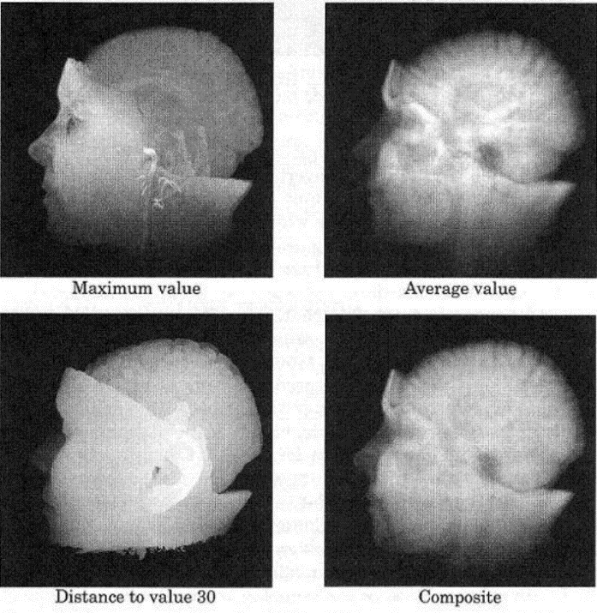
Graphics Application Development
Back to Quick Click
Questions
What is in-situ visualization?
• Rather than write the data to disk, can we perform the visualization on the supercomputer?
• Don’t try to move the data off the supercomputer, build the visualization on the supercomputer while the computation is running
• Display the results of the visualization on a separate workstation
• Also reduces the amount of data that must be saved – no need to save data on disk for visualization
• Ideally distribute the visualization over the supercomputer so the data doesn’t need to be moved between processors
What is seeding and describe one of the techniques that can be used for seeding?
• Finding initial particle positions, called seeding is a difficult problem
• Choosing random positions is a good general strategy, but could miss important features
• If we know the location of the interesting features we can randomly generate seeds within a sphere or along a line at that location
• With a small data set this can be under interactive control, move the sphere or line and see how the paths change
Describe two transfer functions. (view left)
The maximum value or maximum intensity function takes the largest voxel value that is encountered along the ray This is fairly easy to understand and isn’t effected very much by noise in the data
The average value function computes the average voxel value along the ray, this tends to be more representative of the values along the ray
The distance to value computes the distance to a particular voxel value and uses this as the pixel colour
The composite function is the most complex one. This function views the voxel value as an opacity, the opposite of transparency. The opacity is accumulated along the ray to give the pixel values. Regions of low opacity tend to look transparent and allow us to look through the volume

Slide 27
Colour
Human vision system, detectors, frequency response, weighting function, 3 types, not linearly independent, metamers
CIE colour space (X, Y, Z), gamut
Perceptually linear colour spaces, L*u*v* and L*a*b* colour spaces
Differences between device gamuts

Slide 28
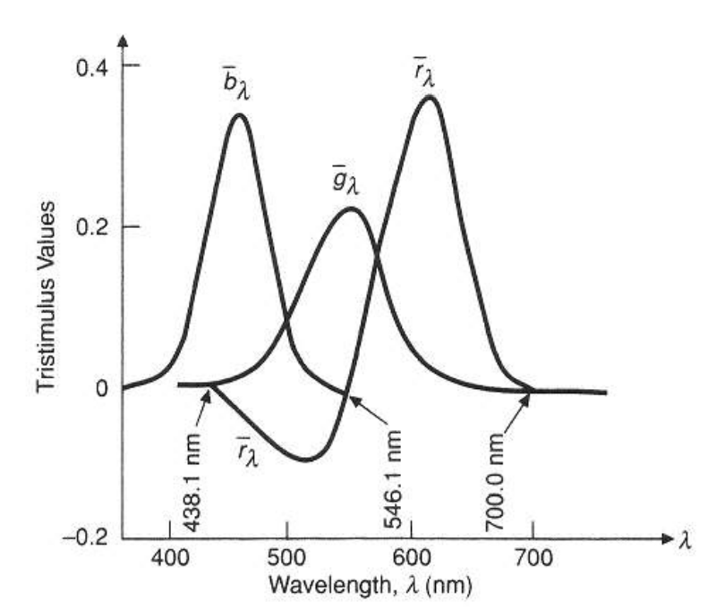
Colour
Back to Quick Click
Questions
What is a metamer?
We can have two spectra that produce the same colour, in this case the spectra are called metamers
These two spectra look totally different, but when viewed they have the exact same colour
Why can’t the RGB colour system be used to produce all visible colours?
• Note that in some cases (view left) we need a negative amount of red, which is not physically possible
• It turns out that we can’t choose three physical colours that can be combined to produce the complete spectrum
What is the main difference between the RGB colour space and the L*u*v* colour space?
The L*u*v is an attempt at a linear colour space, while RGB is a non-linear colour space. We must use formulas to get from RGB space to L*u*v space.

Slide 29
Graphics Hardware
Programmability, simple fragment processing, assembly language, short programs, limited instruction set, integer
Expanded to geometry shaders, floating point, limited control structures, geometry shaders
High level languages: Cg, HLSL, GLSL
Fixed GPU architecture, separate vertex and fragment processors, MIMD and SIMD architectures, load balancing, vertex vs. fragment shaders, screen aligned quads

Slide 30
Graphics Hardware
Unified shader architecture, one type of processor, can execute all shader programs, large number of SIMD processors
Run many copies of program at same time, more silicon devoted to computation
Difference with CPU, stream processing, less need for data storage
Current GPUs, Kepler architecture, massively parallel, thousands of processors

Slide 31
Graphics Hardware
Spatial Light Modulators (SLM)
LCD, polarized light, backlights, HDR
Reflective displays, LCoS, small pixels
DMD, small mirrors, high frequency, small pixels

Slide 32
Graphics Hardware
Back to Quick Click
Questions:
What is the advantage of screen aligned quads when it comes to rasterization?
At the output of the vertex processor the vertices are reassembled into triangles and are then converted into screen aligned quads
• In a screen aligned quad the upper and lower edges are scan lines or rows of pixels on the screen
This makes scan conversion easier, determining the pixels that are covered by the triangle
What is the main advantage of the unified shader architecture?
Removes the issue of idle GPU processors
Why not combine the two types of processors, so they can be switched between vertex and fragment programs depending upon application demand?
• This would make better use of hardware resources and increase performance
• This was the motivation behind the NVIDIA 8800 GPU
• This GPU uses a unified shader architecture where a shader program can be run on any processor
Why does a GPU require less cache than a CPU?
On a CPU a large portion of the area is allocated to cache memory, only a small portion is allocated to computing
• The reverse is the case on a GPU, most of the area is devoted to computing, while there is very little cache
What is the main difference between an LCD and DMD display?
LCDs work by changing the polarization of light, so we have polarizers on both sides of the panel
The polarizers are thin sheets that pass light of only one polarity
Digital micromirror devices (DMD) are based on fabricating very small mirrors on a silicon chip
• These mirrors can move using silicon hinges and springs, see the next slide
In one configuration the mirror reflects light towards the viewer and in the other the light is reflected away from the viewer, this gives basically a binary signal
• We can get grey levels by controlling the amount of time the mirror points towards the viewer
DMDs switch very quickly, much faster the LCDs. They are also very efficient, since there is very little light loss in the reflection, can be used for very bright projectors

